Slide 1
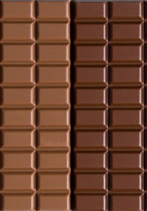

How chocolate is made:
According to Theo’s Chocolate factory. Seattle,WA.
https://www.theochocolate.com/bean-bar-0
AND other sources.
http://jbcutting.com/tasty-thermofoil/
Notes:
I saw a sign once, in a candy shop, with an anonymous quote that read: “Chocolate doesn’t ask silly questions, chocolate understands.” Haven’t most of us at some point, relaxed and indulged in sweet, melt your worries, chocolate? How many of you have ever wondered how that delicious chocolate bar or truffle came to be? My name is Audrey Carroll,and I am here to inform you on the process of making chocolate.

Slide 2

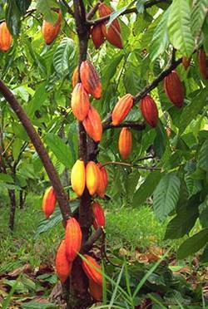
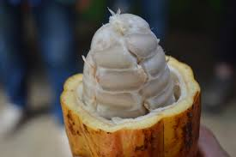
Cacao Trees:
http://www.w-edigest.org/dirt-chocolate-pesticides-and-pollutants-oh-my/
https://en.wikipedia.org/wiki/Cocoa_bean
Cadbury.com, says that most of the world’s cocoa beans are grown in a narrow belt, around ten degrees on either side of the equator. This is because these types of trees prefer humid climates with regular rains and short dry seasons.
http://www.worldagroforestry.org/treesandmarkets/inaforesta/growing_cacao.htm
Notes:
Cadbury.com, says that most of the world’s cocoa beans are grown in a narrow belt, around ten degrees on either side of the equator. This is because these types of trees prefer humid climates with regular rains and short dry seasons.

Slide 3
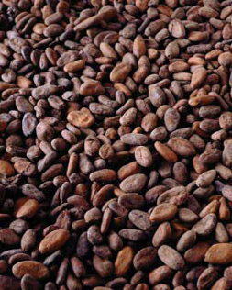
Drying cocoa beans:
The FAO(Food and Agriculture Organization), deems the best method to be….
Dried out in the sun, on boards raised one meter off of ground.
Thin layers, so sun can easily reach and dry the beans.
Cocoa beans need to be dried for five to ten days.
http://www.brecorder.com/
Notes:
The FAO(Food and Agriculture Organization), deems the best method to be….
Dried out in the sun, on boards raised one meter off of ground.
Thin layers, so sun can easily reach and dry the beans.
Cocoa beans need to be dried for five to ten days.
Draw quick sketch on whiteboard.

Slide 4
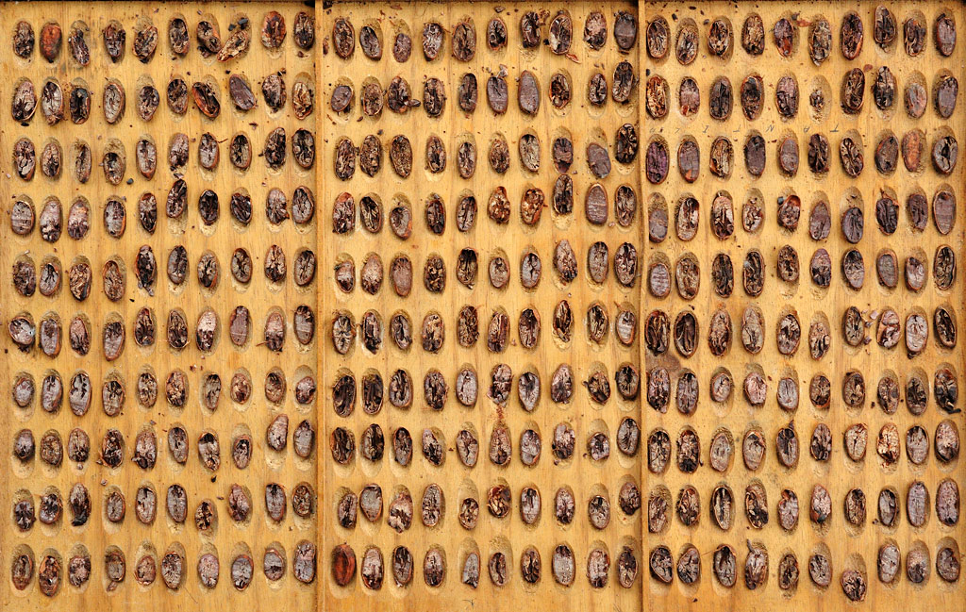
Let the “magic” begin!
Checking for defects.
Making sure none of the beans have germinated.
Looking for moldy beans.
Searching for flaws like beans that are either under or over fermented.
Cleaning
All beans arrive a bit dusty but there also could be foreign objects accidentally mixed up with the beans.
The beans go through a dry process, where they are gently bounced around to get rid of rocks or other unwanted matter.
http://www.foto-grafo.de/Cocoa/cocoa_5.html
Notes:
Checking for defects.
Making sure none of the beans have germinated.
Looking for moldy beans.
Searching for flaws like beans that are either under or over fermented.
Cleaning
All beans arrive a bit dusty but there also could be foreign objects accidentally mixed up with the beans.
The beans go through a dry process, where they are bounced around to get rid of rocks or other unwanted matter.

Slide 5
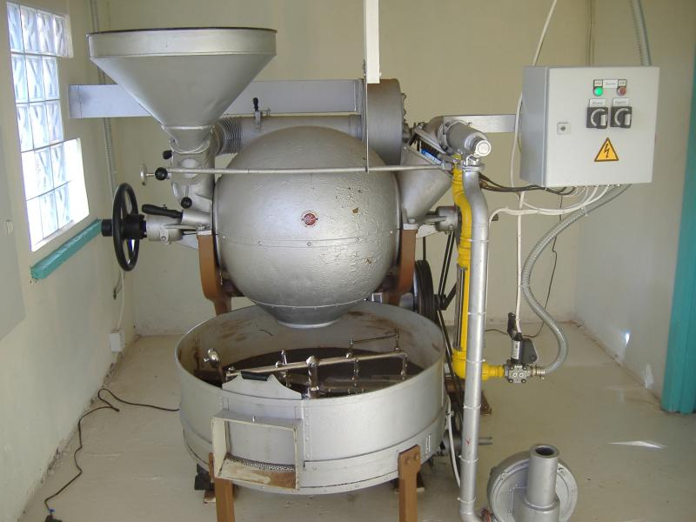
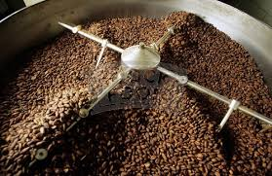
Roasting:
The desired flavor(rich, light, dark, very dark, partially dark) needs to be taken into consideration, before roasting the beans for any batch of chocolate.
Unlike coffee beans, cocoa beans need to be roasted low and slow.
Temperatures should go no higher than 300℉ .
Beans should be roasted for at least 35 min. to no longer than 65 min.
2 goals of roasting at Theo’s chocolate factory
Reduce the moisture content of the beans.
Sterilize the beans.
https://www.grenadachocolate.com/tour/roasting/
http://www.glogster.com/glog/6md060lbl6j5qmqg5haqta0.html
Notes:
The desired flavor(rich, light, dark, very dark, partially dark) needs to be taken into consideration, before roasting the beans for any batch of chocolate.
Unlike coffee beans, cocoa beans need to be roasted low and slow.
Temperatures should go no higher than 300℉ .
Beans should be roasted for at least 35 min. to no longer than 65 min.
2 goals of roasting at Theo’s chocolate factory
Reduce the moisture content of the beans.
Sterilize the beans.

Slide 6
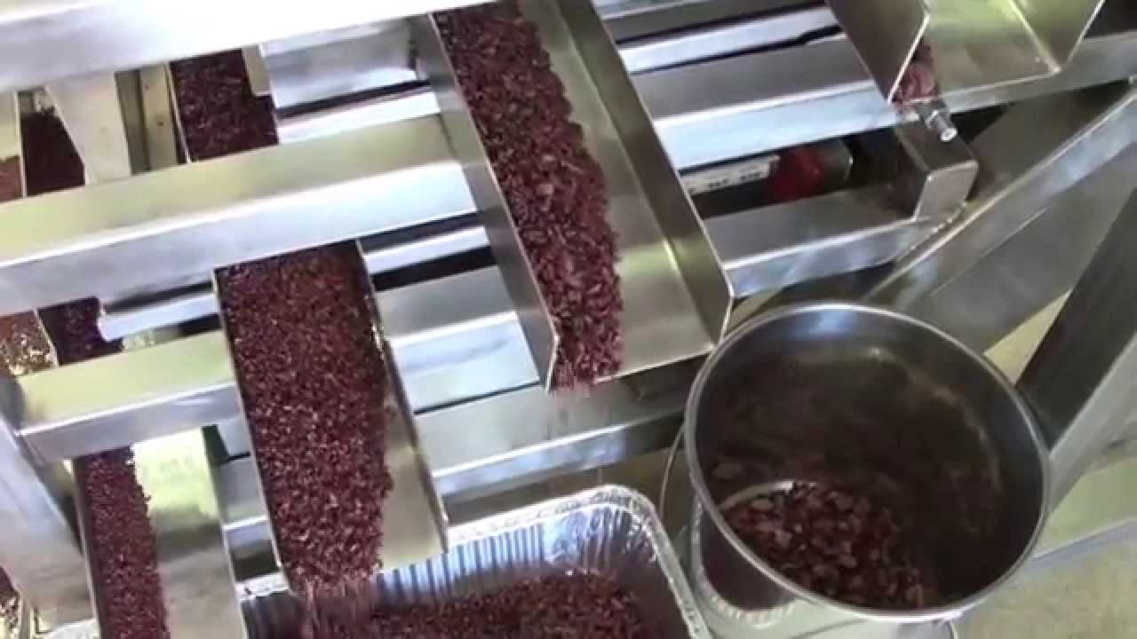
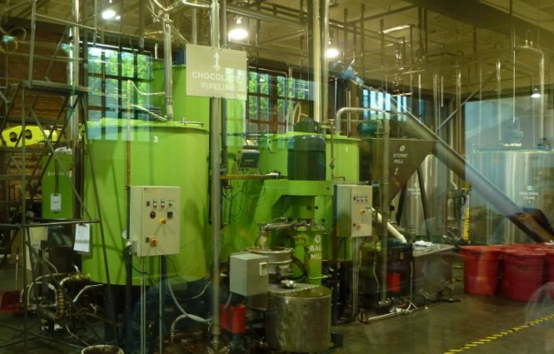
Winnower-to-Mill:
Once the beans have cooled after roasting, they are transported to the winnower machine.
The winnower’s task is to remove the husks from the cocoa beans.
It also breaks them into small pieces called nibs.
Nibs can be eaten by themselves or used in cooking.
The milling process takes many hours and is where the nibs are ground down.
Process frees cocoa butter from beans and results in what is called chocolate liquor, though it is non alcoholic.
The chocolate liquor is then agitated with tiny steel balls until the particle sizes in it are about the size of a red blood cell.
Finer particles make for rich, smooth chocolate.
https://www.youtube.com/watch?v=oVEwnLm4Xf4
http://www.annetrent.com/2014/02/theo-chocolate-factory/
Notes:
Once the beans have cooled after roasting, they are transported to the winnower machine.
The winnower’s task is to remove the husks from the cocoa beans.
It also breaks them into small pieces called nibs.
Nibs can be eaten by themselves or used in cooking.
The milling process takes many hours and is where the nibs are ground down.
Process frees cocoa butter from beans and results in what is called chocolate liquor, though it is non alcoholic.
The chocolate liquor is then agitated with tiny steel balls until the particle sizes in it are about the size of a red blood cell.
Finer particles make for rich, smooth chocolate.

Slide 7
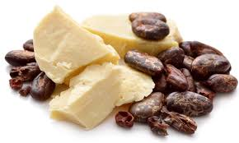
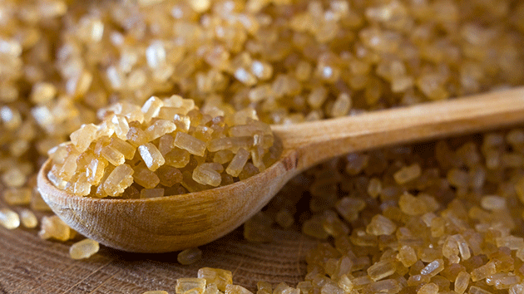
Refinement:
http://www.justdermatology.com/tag/cocoa-butter/
After the nibs have gone through the mill, the chocolate liquor is separated into different portions. Coarse granulated sugar is added to some of it, then it is mixed and ground at a high speed. This mixture started out as a paste, but ends up a dry powder called cocoa flakes. Cocoa flakes form because, as the sugar is ground finer, it gains more surface area and absorbs the chocolate liquor.
http://www.motherjones.com/environment/2014/09/is-raw-sugar-healthier-than-refined
Notes:
After the nibs have gone through the mill, the chocolate liquor is separated into different portions. Coarse granulated sugar is added to some of it, then it is mixed and ground at a high speed. This mixture started out as a paste, but ends up a dry powder called cocoa flakes. Cocoa flakes form because, as the sugar is ground finer, it gains more surface area and absorbs the chocolate liquor.

Slide 8
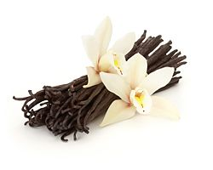
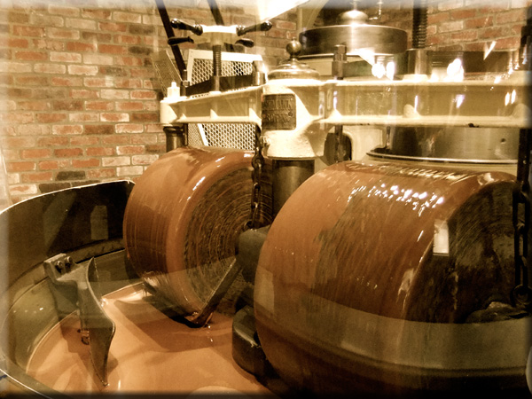
Finalizing Flavors:
From the refiner, the cocoa flakes begin the conching process.
The flakes get heated and slowly combined with more chocolate liquor.
Depending on the origin of the beans, batch size, cocoa percentage, and recipe; conching can take anywhere from 12 hours to 2 days.
Once conching is complete, vanilla flavoring(usually organic) and more cocoa butter is added. The extra cocoa butter is to help reduce the viscosity of the chocolate so that it flows and spreads more easily.
http://www.lotioncrafter.com/vanilla-bean-specks.html
https://chocolateclass.wordpress.com/2015/02/21/from-sacred-to-commonplace-the-transformation-of-chocolate-consumption-2/
Notes:
From the refiner, the cocoa flakes begin the conching process.
The flakes get heated and slowly combined with more chocolate liquor.
Depending on the origin of the beans, batch size, cocoa percentage, and recipe; conching can take anywhere from 12 hours to 2 days.
Once conching is complete, vanilla flavoring(usually organic) and more cocoa butter is added. The extra cocoa butter is to help reduce the viscosity of the chocolate so that it flows and spreads more easily.

Slide 9
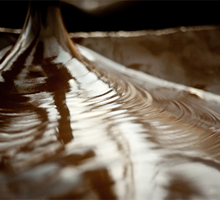
Concluding Temperament:
The chocolate is kept warm, in holding tanks until it is ready for tempering and use.
Tempering the chocolate is what gives it it’s shine and snap.
The chocolate gets heated until it’s cocoa-fat molecules break up.
Then the chocolate is aggressively cooled down, to help solidify it again.
From there the chocolate is ready to have other ingredients added to it and made into bars or truffles, and other sweets.
https://www.theochocolate.com/bean-bar-0
Notes:
The chocolate is kept warm, in holding tanks until it is ready for tempering and use.
Tempering the chocolate is what gives it it’s shine and snap.
The chocolate gets heated until it’s cocoa-fat molecules break up.
Then the chocolate is aggressively cooled down, to help solidify it again.
From there the chocolate is ready to have other ingredients added to it and made into bars or truffles, and other sweets.
So next time you relax and unwind with a piece of chocolate, take a second to remember how much work went into getting it there.

